Slide 1
Finance Supply Chain Management (FSCM) Basic Concept
Prabhakar Mishra
Business Analyst

Slide 2
Organizational Strategy
Today’s organizations need to be SMART enough to generate profit and value for its stake holders to stay in the game. The current global economic scenario has left companies reeling for cash and liquidity and the term Easy money and liquidity being replaced by Cautious approach. The money lenders have become more cautious in their approach and have reduced their risk appetite as they are also running short of cash and capital.
So apart from focusing on top line and bottom line, companies are giving much importance to Cash Flow figures and liquidity ratios. We have seen many firms almost crumbling under pressure and their daily operations coming to a halt in the recession times, although they had good bottom line.
SMART organizations are focusing more on Cash Flow management that can lead to a lower working capital and improve efficiency.
SAP FSCM package solutions help organizations to be SMARTER and achieve goals.

Slide 3
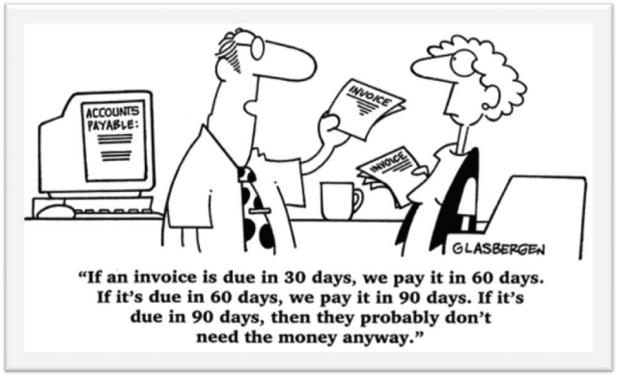

Slide 4
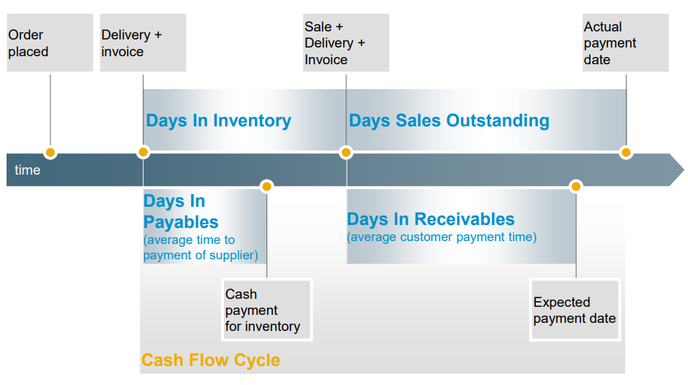

Slide 5
Financial Supply Chain Management (FSCM) in simple terms means managing demand and supply of cash/cash equivalents. SAP has come out with SAP FSCM functionality or suite of applications to manage this more effectively and efficiently thus helping companies to manage the costs associated with this process better.

Slide 6
Prior to ECC 5.0 most of the functionality supporting business processes related to claims, dispute, and credit management were handled outside SAP application using legacy systems or handled manually. Integration with the Account receivable and cash management was more of a manual activity in most of the cases.
With ECC 5.0 SAP introduced SAP Financial Supply Chain Management (FSCM). Key objective is to bring business processes on the receivables and collection side within SAP solution thus providing more value. It helps in tying all the loose ends around receivables, collections and cash management within the organization thus leading to better integration and last step connect with the customers.

Slide 7
Key Application within SAP FSCM
Electronic Bill Presentment and Payment - This application provides a better and more real time interfacing with the customers and vendors with added benefit of self service to view the accounts as well as make electronic payments. It is mainly caters to presenting the invoices and account statements to the customer and vendors over the internet. Key benefit is reduction in overheads and cycle time associated with this process for both - organization as well as its customer and vendors.
Collections Management - This application provides the functionality to manage the collections more efficiently and effectively. This is similar to the collection management functionality already present in SAP FI-AR component with added features like sending payment reminders, portal catering to collection agents, devising collection strategies and managing agreements related to payments from customer.
Credit Management - Provides with functionality to manage credit policies and risks associated with the receivables centrally - even for scenarios where the business is supported by multiple instances across the globe. Thus helps in implementing uniform credit policies and rules across the globe as well as have one view for a customer who is dealing in multiple countries. It also brings in functionality of managing complex customer credit account hierarchies and rules associated with it.
Dispute Management - Facilitate and automate a lot of manual activities involved in handling disputes related to payments related to receivables in electronic form. This also leads to better integration and flow of information across multiple stakeholders involved to resolve the disputes.

Slide 8
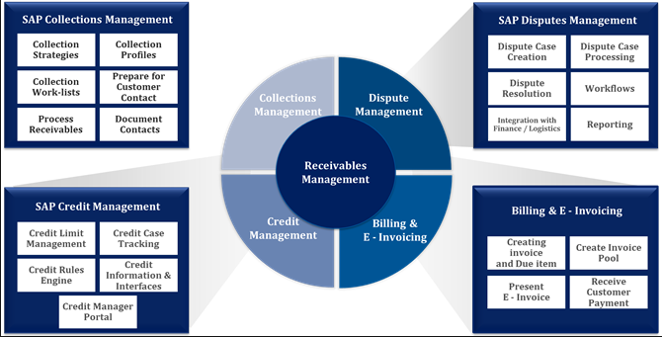
SAP FSCM Cycle

Slide 9
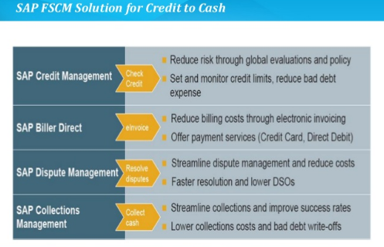
Key benefits SAP FSCM

Slide 10
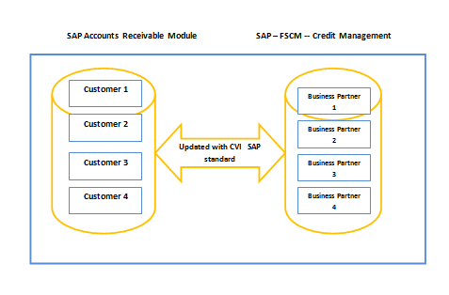
BP Relationship

Slide 11
Finance Supply Chain Management (FSCM) Collection Management
Prabhakar Mishra
Business Analyst

Slide 12
Collections Management – Important Business Issue
Increasingly bad payment behavior
❑ Increasing Days Sales Outstanding (DSO)
❑ No reaction on automatic correspondence like dunning
❑ Financial situation influences customer relationship
Collections Management today is mostly a time-consuming, costly and cumbersome process
❑ Select and prioritize customers to be collected
❑ Search for account information
❑ High volumes

Slide 13
What Are the Business Objectives?
Increase share of collected receivables
❑ Reduce Days Sales Outstanding (DSO)
❑ Avoid write-offs
❑ Increase payments on time
Decrease cost of cash collection Improve Customer Relationship Management
❑ Retain valuable customers and convert difficult customers by providing the right
interaction in delicate scenarios
❑ Provide complete picture of customer history
❑ Increase customer satisfaction

Slide 14
How Does SAP Collections Management Help?
SAP Collections Management provides collection strategies that allow to select and prioritize customers for the collection of receivables
❑ Collection strategies are the basis for the automatic creation of daily worklists for collection specialists.
❑ Worklists ensure evaluation, identification, stratification and prioritization of customers according to collection strategy
❑ Daily worklists improve user productivity and efficiency
SAP Collections Management offers special collection procedures to document and react on customer contacts
❑ Promise to pay agreements
❑ Dispute cases (via integration with SAP Dispute Management)
❑ Resubmissions
❑ Customer contacts
Collection managers will find a variety of options to control the collection of receivables
❑ Define and adapt strategies
❑ Maintain collection groups
❑ Workforce management by reassigning worklist items and monitoring degree of worklist processing

Slide 15
Terms & Concepts
EBO FSCM
Customer → Business partner (BP)
Accounting clerk → Collection specialist
Team of accounting clerks → Collection group
Prioritizes the BPs on the work list → Collection strategy
Call cycle → Work list
Customer’s agreement to pay → Promise to pay
Query handler → Dispute Coordinator
Query/inquiry → Dispute

Slide 16
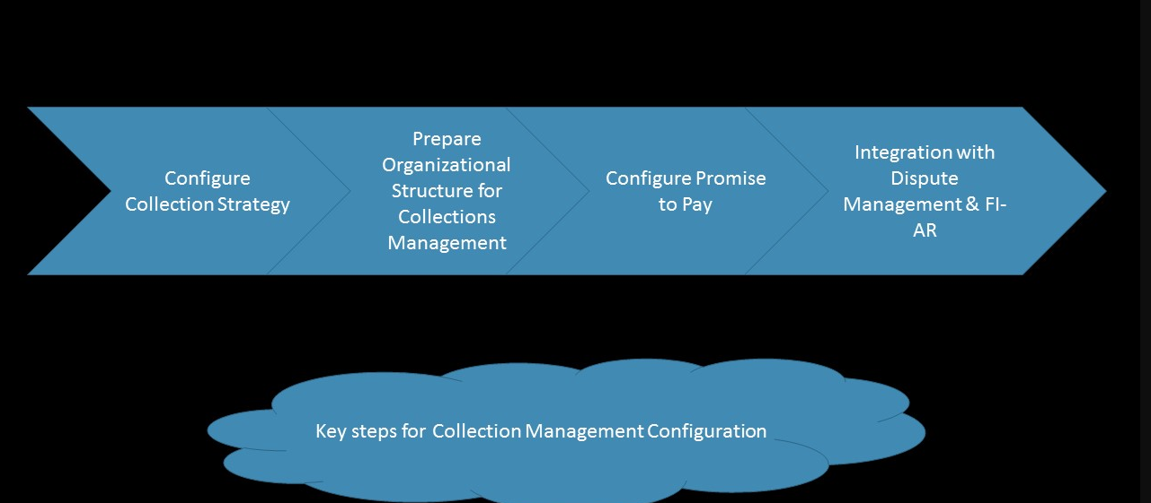
Key Steps of Configuration of Collection Management

Slide 17
Collection Strategy
It decides the prioritization of customers for collections and also decides the information in the worklist which is used for collections management.
The Prioritization of Customers is done on the basis of Certain Rules. These Rules is defined according the Company’s own requirement.
The set of rules are evaluated to calculate a score.
Score is used to arrive at the priority that is used on the work list.

Slide 18
Key Steps to Define the Collection Strategy
The Collection Strategy is configured on the basis of Business requirement , which is completely customized. There are certain key steps involved in defining the collection strategy :
Define Basic Rules
Define Collection Rules
Process Priorities
Defining derivation of priorities
Collection Strategy

Slide 19
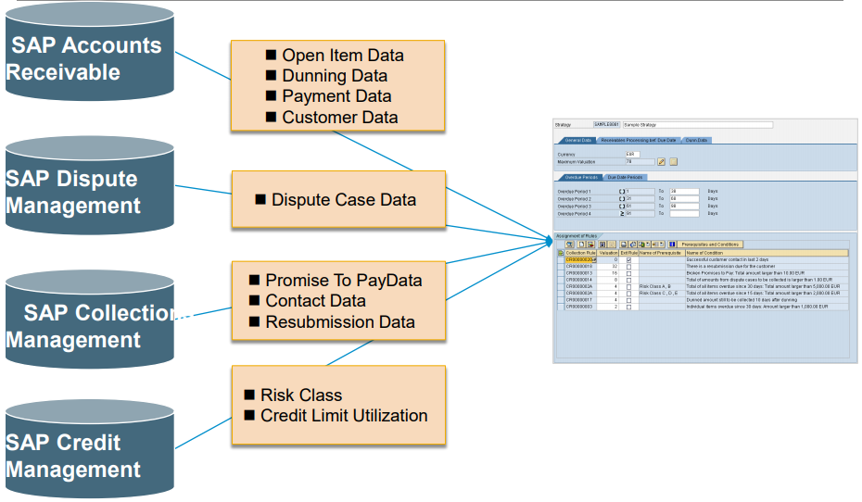
Priorities (Rules) for Collection Strategies
Data Sources for Collection Rules

Slide 20
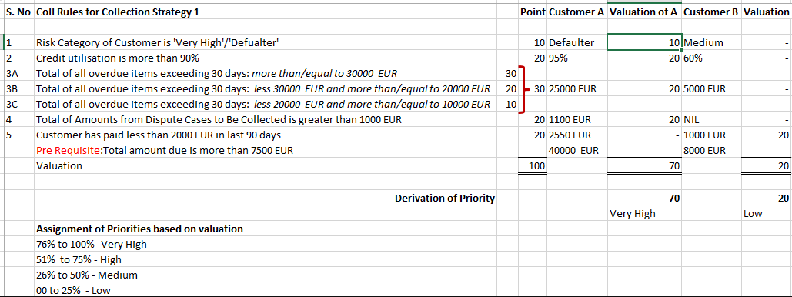
Collection Strategy

Slide 21
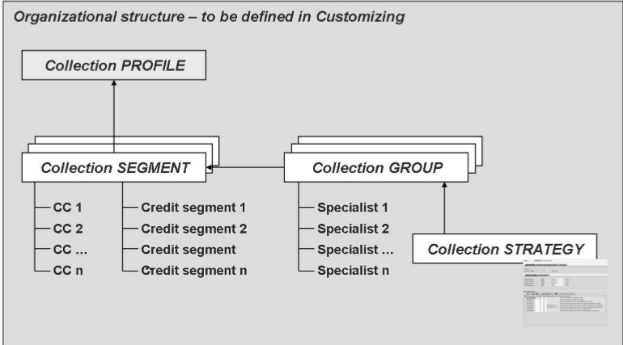
Organizational Structure

Slide 22
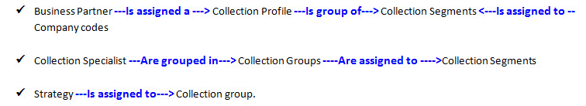
Assignment

Slide 23
FSCM Collection Management Configuration

Slide 24
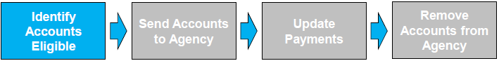
Collection Agency Process
•An automatic job will run overnight identifying all the accounts that are eligible
for submission to a collection agency.
•Users will review the proposal using an online transaction and select the accounts
to are to be submitted to the collection agency.
•Drill-down facility to see customers lines items is available
•Major customers cannot be added

Slide 25
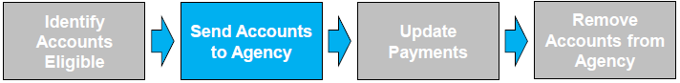
Collection Agency Process
•An automated job will send the selected accounts to external collection agencies on a weekly basis.
–Collection group will be automatically updated
–Dunning blocks will be automatically applied.
•The file will be automatically transferred to the collection agency.
•Collection Agency receive file and upload customers and invoices into their system.
•Agency starts collection process:
–Sends standard letter
–Contacts the customer

Slide 26
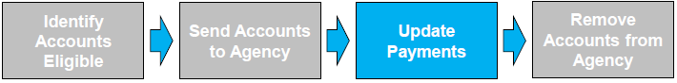
Collection Agency Process
•Customer will send the payments to XYZ Inc, not the collection agency.
•Payments will be allocated to the customers account/invoice(s) within SAP R3.
•A Payment Extract file will be automatically created and transferred to external
collection agencies on a daily basis.
•Collection Agency receive file and update customers balances in their system.

Slide 27
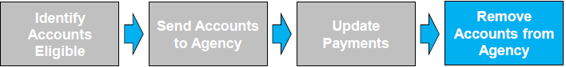
Collection Agency Process
•Customer will removed from the collection agency:
–Account is paid in full
–Transferred to Legal
–Returned from agency i.e. no trace
•Collection group automatically updated:
–Paid: Original Group
–Legal: Legal Collection Group
–Returned from Agency – User Intervention
•Dunning Blocks automatically removed
•Resume normal collection activity.

Slide 28
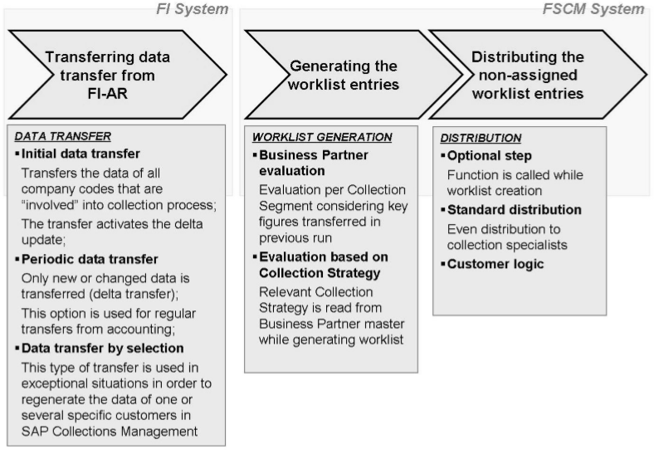
Flow FI-AR→ FSCM – Collection Management

Slide 29
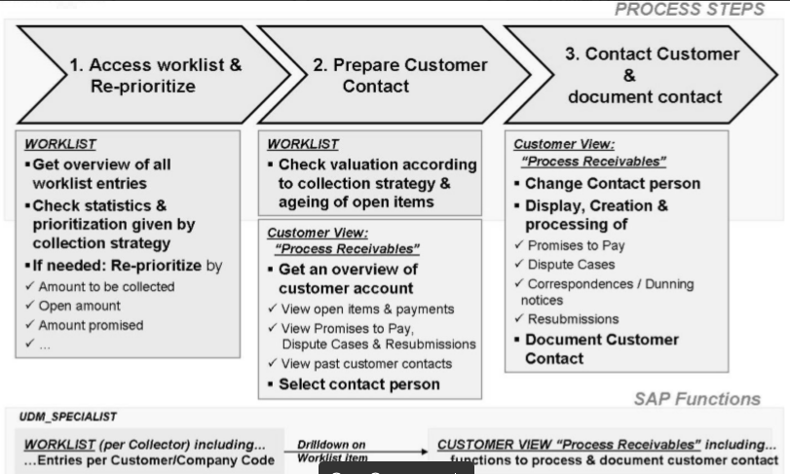
Specialist Role

Slide 30
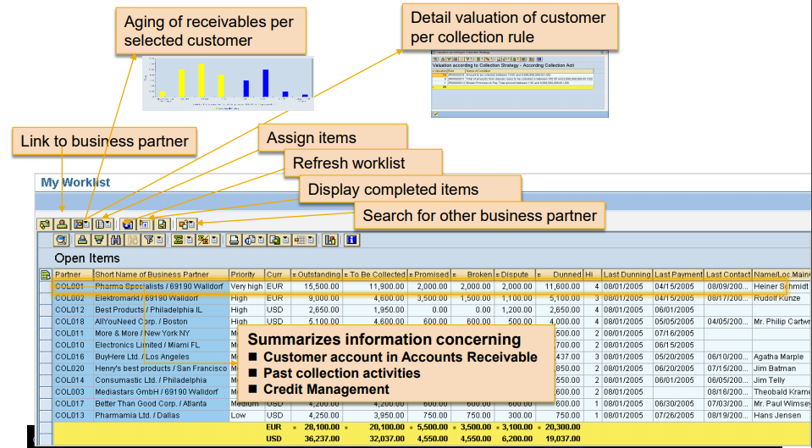
Collection Worklist
Each collection specialist gets a daily worklist containing all customers who should be contacted. Customers are valuated and prioritized according to collection rules in a collection strategy.

Slide 31
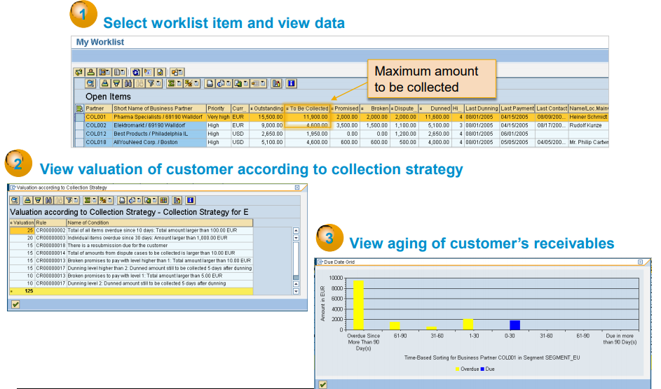
Worklist as Starting Point for Customer Contact

Slide 32
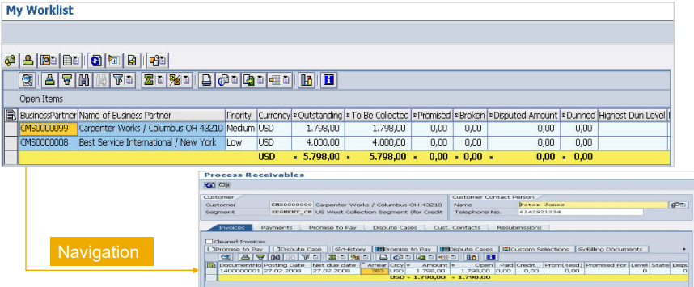
‘Process Receivables’ Function – Main Area During Contact
To contact the customer, the collection specialist navigates from the selected worklist item to the „Process Receivables‟ function. This function offers detailed customer information and supports various collection activities.

Slide 33
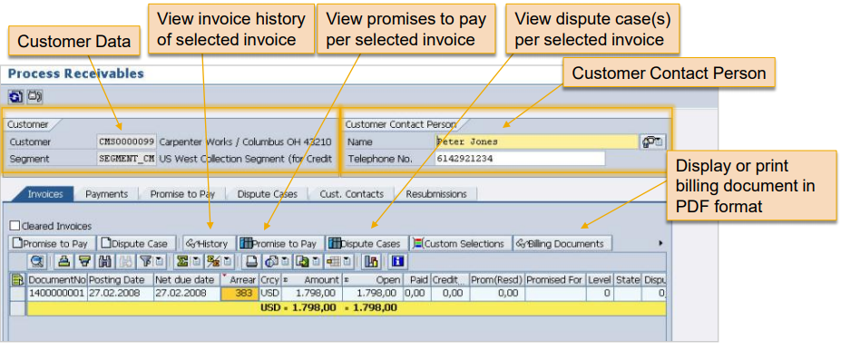
Process Receivables – Invoices (Open)
On the „Invoices‟ tab page the collection specialist gets an overview of all open invoices of a customer in a collection segment. Per invoice the status is displayed including the amount invoiced, open amount, disputed amount, amount promised to pay, state of promise etc.

Slide 34
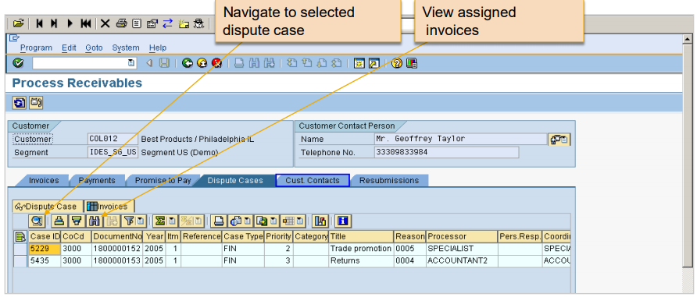
Process Receivables – Dispute Case
The overview on dispute case shows all dispute cases that are related to the open invoices listed on the „invoices‟ tab. You can navigate to a selected dispute case and – if you have the authorization – process the dispute case. Furthermore, you can display which invoices are assigned to the dispute case.

Slide 35
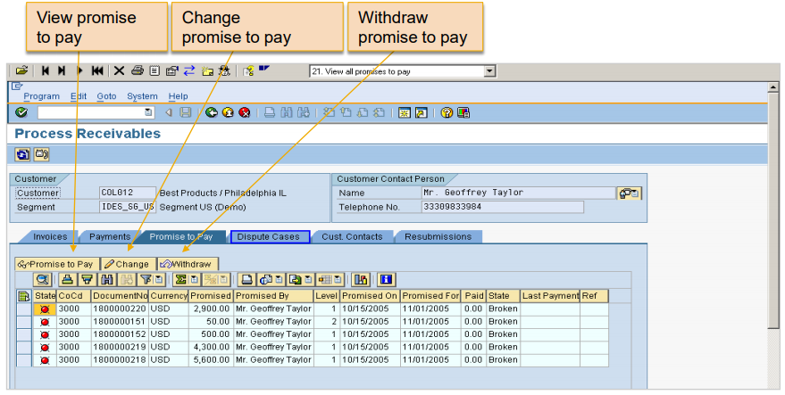
Process Receivables – Promise to Pay
The overview on promise to pay shows all promises to pay that were given for the open invoices displayed on the „invoices‟ tab. You can navigate to the details of a selected promise to pay, change or withdraw a promise to pay.

Slide 36
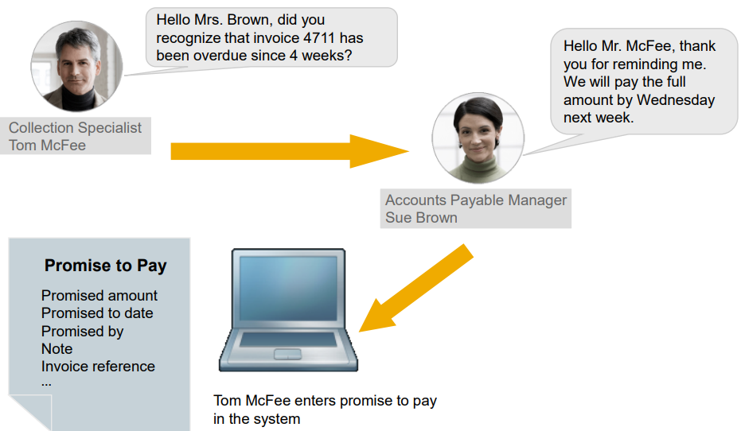
Promise to Pay Process

Slide 37
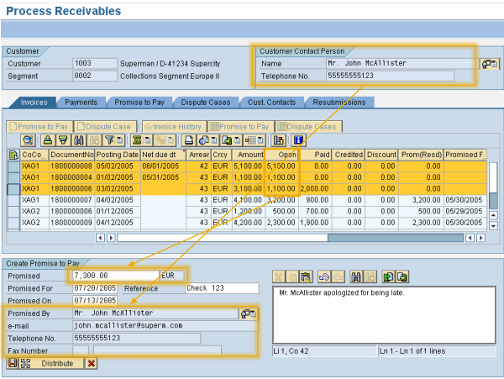
Create Promise to Pay
The collection specialist can create a promise to pay in the system for the selected invoices. The total of all open amounts is proposed by the system as promised amount. If the promised amount is less than the proposed amount, the promised amount can be distributed to the invoices.

Slide 38
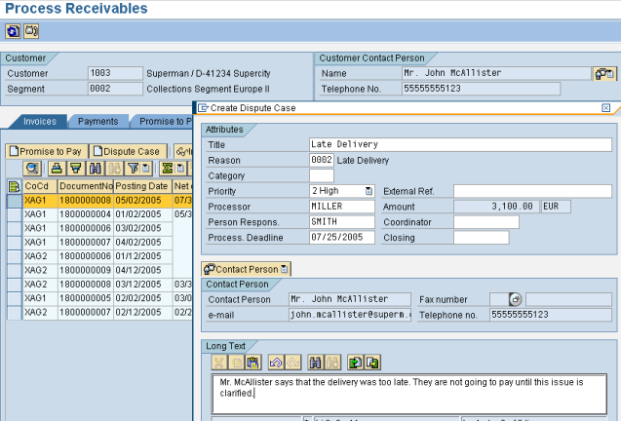
Create Dispute Case
The collection specialist can create a dispute case for the selected invoices. The total of all open amounts is proposed by the system as disputed amount. The collection specialist can enter all necessary information such as dispute reason and a note.

Slide 39
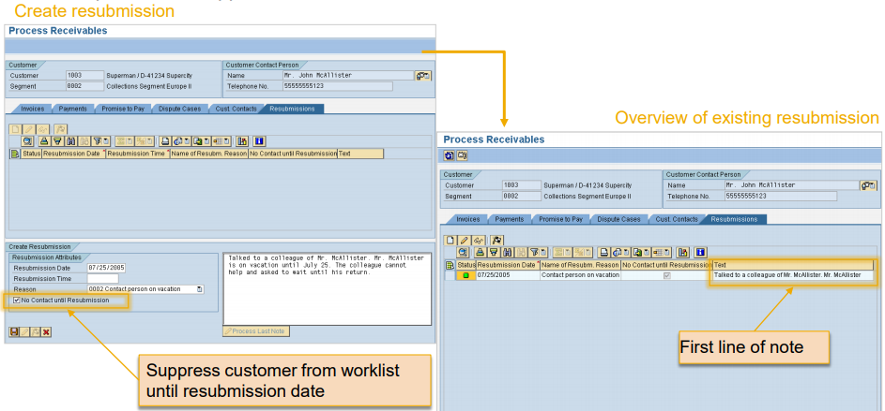
Resubmission
Collection specialists can set a resubmission for a customer. They can enter a note and a resubmission reason. The customer will re-appear on the worklist at the resubmission date. It is also possible to suppress a customer from the worklist until the resubmission

Slide 40
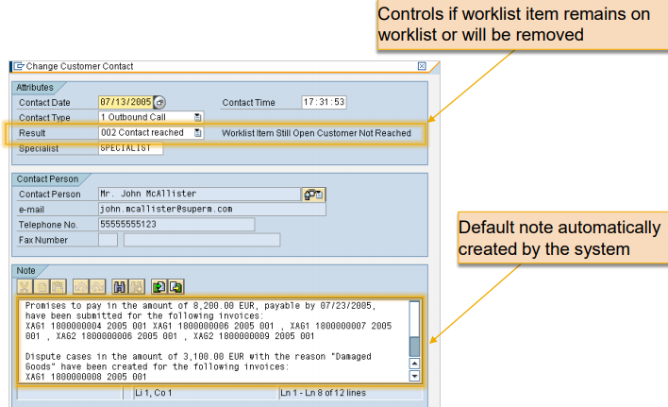
Create Customer Contact
The collection specialist can document the outcome of the whole customer contact. Dispute cases, promises to pay and resubmissions created during the contact will be automatically assigned. A default note is set by the system and can be enhanced by the specialist.

Slide 41
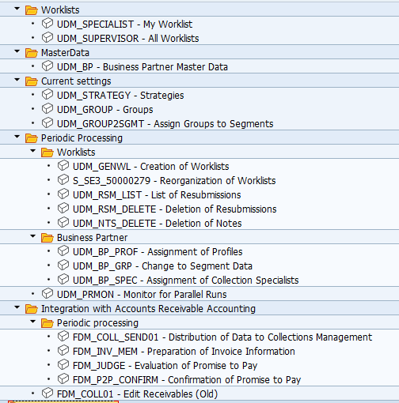
Transaction Code

Slide 42
Finance Supply Chain Management (FSCM) Dispute Management
Prabhakar Mishra
Business Analyst

Slide 43
Introduction
Dispute Management is an integral part of the Financial Supply Chain Management Solution. The dispute management solution integrates with the AR Application to effectively track AR Items which are in dispute for collection from the customers. The AR Items which are in conflict are marked as dispute and an object is created against the item. This object is called as Dispute Case. The dispute case can be created in many ways:
1. A dispute case can be created in a specific financial transaction
2. The dispute case can also be created through the customer line item display
3. The dispute case creation can also be automated for scenarios like Under Payment or if the Open Item has reached a certain Dunning Level
A dispute case is a detailed document to record the reason for disputed item, the information of the person following up on the same and the various stages of communication on the same. When the dispute is resolved, the case is closed with an appropriate action.

Slide 44
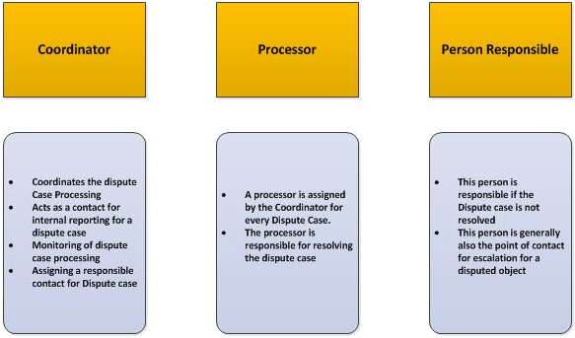
Major Role
There are three major roles which are involved in dispute management:
(a) Coordinator
(b) Processor
(c) Person Responsible

Slide 45
Hierarchy Structure
Case Creation
Automatic
Under Payment
Dunning
Manual
Customer Line Item

Slide 46
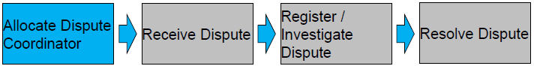
Dispute Case Process
•Manual activity to allocate coordinators
•Mass change transaction available
•Daily/Weekly job to update newly created business partners
•Collection Specialist is assigned as dispute coordinator for partial payments and write-offs

Slide 47
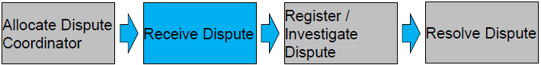
Dispute Case Process
•Disputes can be received from:
–Incoming call / correspondence
–Partial payment from cash allocation
–Online via Biller Direct from customer
–Collections activity by specialist
•Priority defaulted based on age, value, classification and collection group type

Slide 48
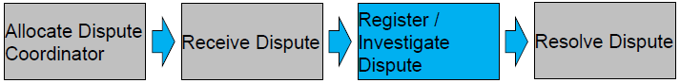
Dispute Case Process
•Update reason code for Biller Direct disputes
•Update status to in process
•Dunning, payment and interest blocks automatically applied
•Dispute assigned can be assigned to processor to complete tasks towards the
resolution of the dispute case
•Details recorded in the notes section.
•Documents can be attached

Slide 49
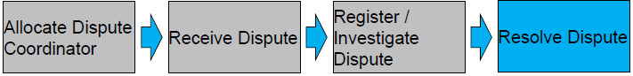
Dispute Case Process
•Perform resolution activity
–Raise credit
–Send documentation
–Advise customer no credit due
•Status updated to resolved
•Dispute closed for KPI reporting
•Dunning, payment and interest blocks automatically released
•When the invoice is cleared status updated to closed automatically

Slide 50
Configurational Steps

Slide 51
Finance Supply Chain Management (FSCM) Credit Management
Prabhakar Mishra
Business Analyst

Slide 52
Introduction
The payment behavior and credit worthiness of the business partner/customer have immediate impact on the business result of an organization. Efficient credit management reduces the risk of business losses, optimizes the credit risk and improves relationship with the business partner.
The traditional credit management has been stayed for a longtime. Most of the companies using FI-AR and SD have implemented the traditional credit management to avoid the losses because of credit risk. The FIN-FSCM-CR takes the credit management to a different level. The FSCM credit management (FIN-FSCM-CR) provides enhanced functionality to monitor credit and exposure risk of a company. It is an extension over the traditional credit management (FI/SD-CM), which enables the user to have better control and more transparent view on receivables. Based on my experience, I have summarized the basic differences between the two ways of managing the credit in SAP.

Slide 53
Difference between Traditional and FSCM Credit Management
Area | Traditional Credit Management | FSCM Credit Management | Remarks
Organization element | Credit Control Area | Credit Segment – Many segments can be linked to a main segment | The credit segment is associated with a credit control area. Each credit control area can be assigned to one credit segment only.
Master data | Uses AR master data | Requires creation of Business partner master data | Based on the customizing setting the business partner master data is synched up with the customer master data.
Types of credit check available | Automatic Check and Static Credit Check | Only “Automatic credit control” will be available | The basic credit management setting remain same in both FI/SD-CR and FIN-FSCM-CR.
Storing credit rating of external rating companies | Not Available. | Can store credit rating of many companies in business partner. | An interface can be set-up to get the data from credit rating company.
Interfacing with credit rating company | Not Available. | Possible through XML interface | Not Applicable for traditional credit rating company as there is no possibility to store the credit rating of various rating companies.

Slide 54
Difference between Traditional and FSCM Credit Management
Area | Traditional Credit Management | FSCM Credit Management | Remarks
Defining blocking reason | Not Available. | Available. | FIN-FSCM-AR provides blocking of business partner data providing a reason code.
Credit Exposure data | Available at credit control area level. | Available at credit segment level with the breakup under each category.
Credit limit data | Needs to collect from external company and uploaded manually based on manual calculation | Can be derived based on both internal and external data. | FIN-FSCM-CR, credit limit data can be requested within SAP and based on external and internal rating the limit can be calculated within SAP system.
Additional Set-up requires | Not Required | Maintaining interface through XI/PI or point to point interface. | WS-RM can be used from ECC6.0 EHP5. The interface is used for real-time exposure and transaction data flow between AR and FSCM credit management. This is required because of distributed architecture of FSCM.

Slide 55
Difference between Traditional and FSCM Credit Management
As we have seen here, the FSCM-Credit management has same underlying functionality as that of the traditional credit management. FIN-FSCM_AR doesn’t replace the traditional credit management but is simply is an extension over the existing credit management. With the implementation of the FIN-FSCM-CR, the companies are able to reduce the manual work, streamline adhoc work, and make better decision for credit management based on the internal as well external data.

Slide 56
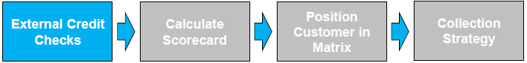
Process for Customer
•ABC Inc Customers are matched with D&B.
•External Credit data is uploaded for eligible customers on a quarterly basis:
–Customers in Liquidation and legal proceeding are excluded.
–An automatic job will run overnight identifying all the accounts that are eligible to
for the external credit data.
•External Credit Data is used in the scorecard.

Slide 57
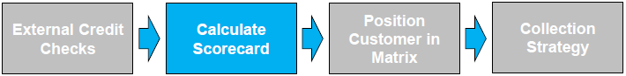
Process for Customer
•Statistical Scorecard designed to predict future behaviour.
•Scorecard predicts ‘Bad’ customers
•Scorecard to be run monthly.
•Calculated Score is mapped to one of the 6 system risk classes.
•System risk classes are mapped to the 3 risk classes used in the Divisional Customer
Strategy.
•Dunning Procedure automatically assigned (more details in collections management)
•Credit Limit Calculated

Slide 58
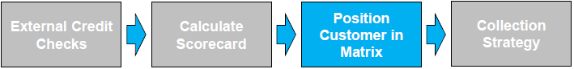
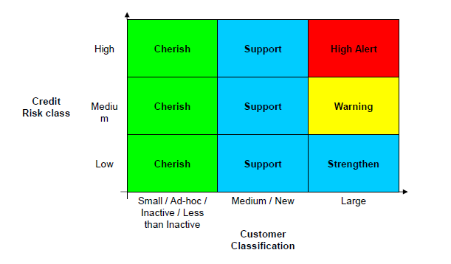
Process for Customer

Slide 59
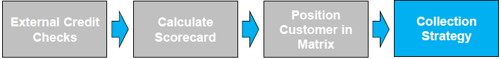
Process for Customer
•The collection strategy contains the following and will be discussed in more detail within Collections Management:
–Worklist
–Dunning Procedures
–Collection Agency

Slide 60
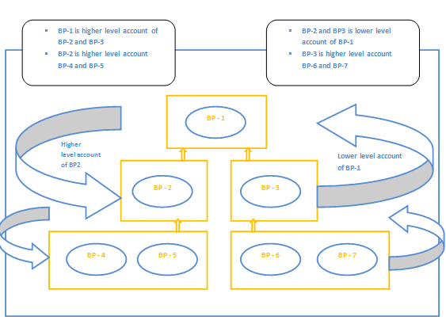
BP Relationship Hierarchy

Slide 61
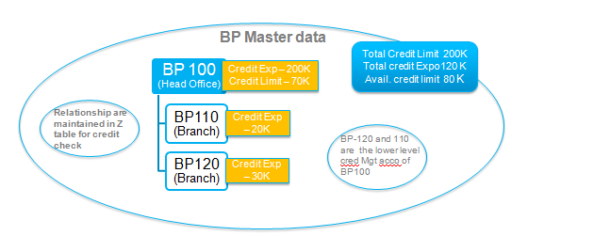
Credit Check

Slide 62
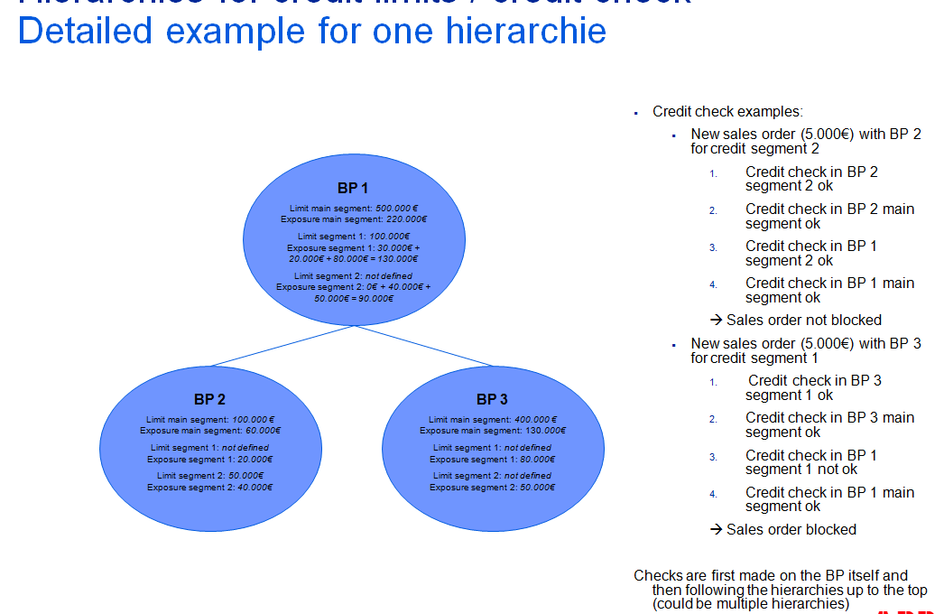
Credit Check

Slide 64
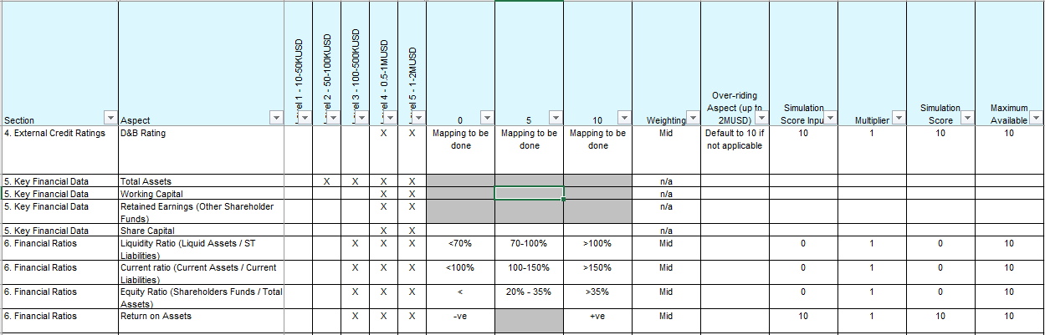
Score Card

Slide 65
FSCM Credit Management Configuration

